Slide 1
MET CS 555 – Foundations of Machine Learning Lecture 5: Linear Regression
Hongsheng Wu
Boston University

Slide 2
Study Guide
Scatterplots
Correlation
Simple Linear Regression

Slide 3
Scatterplots

Slide 4
Scatterplots
Display the relationship
between two continuous or
quantitative factors
Shows the relationship between
two paired factors
Each "pair" of data is shown
with one single point.

Slide 5
An Example - Scatterplots
Is there an association between the number of hours spent on studying and the performance on the final exam?
Use the plot() function to draw the scatterplot
Many Attributes:
Use main, xlab, and ylab to label the picture appropriately
Use xlim and ylim to control x and y axises
Change the type of point using pch and/or the color of the point using col
Change the size of the points or the labels using cex, cex.axis, cex.main, etc.
See ?plot() for documentation

Slide 6
plot() Options for pch

Slide 7
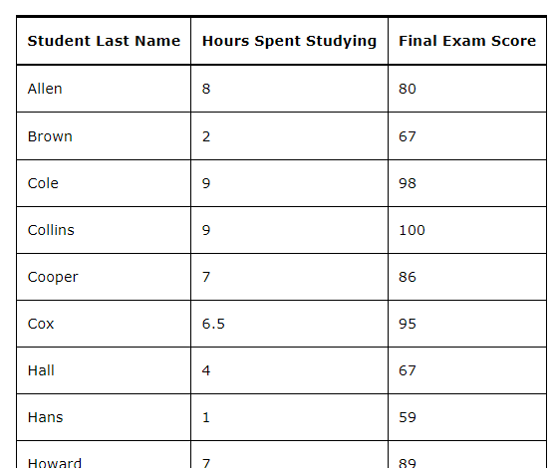
Scatterplot Example

Slide 8
Response Versus Explanatory Variables
Generally, we put
the explanatory variable on the x-axis
and
the response variable (the outcome of interest) on the y-axis (vertical axis)
Explanatory variables are also called independent variables
Response variables are called dependent variables (because the response variable may depend on the explanatory variable)
If there is a temporal relationship (if one variable comes before another) then the explanatory variable is generally the one that occurs first
If there is not a temporal relationship, then to figure out which may be a better choice for the explanatory variable, you may ask yourself which factor may depend on the other

Slide 9
Example – Investing in an Irrigation System
A farm in upstate New York is evaluating whether or not to invest in an irrigation system. They have data over the last few years on average rainfall (in inches during the growing season) and pounds of apples produced. If the amount of rainfall is associated with the crop yield, they may choose to make the investment.
Which is the response variable, and which is the explanatory variable in this case?
Rainfall during the growing season occurs temporally before the crops produce their yield.
A choice is that the response variable is pounds of apples, and the explanatory variable is average rainfall.

Slide 10
Example – Are SAT Math and Verbal Scores Associated?
Are SAT math and verbal scores associated? To find out, a high school collects the math and verbal scores of their students.
If we make a scatterplot of these data, which should go on the x-axis?
Generally, the explanatory variable goes on the x-axis of the scatterplot. However, in this case, there is not a clear choice for the response and explanatory variables.
There is no reason to think that one’s SAT math score depends on one’s SAT verbal score, or vice versa. As such, either score could go on the x-axis.

Slide 11
Exercise
A student is interested in how voting patterns change over time and looks at the percentage of voters in each state that voted Republican in the 2008 versus the 2012 election years. What is the response variable and what is the explanatory variable?
Since these two factors are temporal in nature, the explanatory variable is the one that occurs earlier in time. That is, the explanatory variable is the percentage of voters in each state that voted Republican in 2008 and the response variable is the percentage of voters in each state that voted Republican in 2012.

Slide 12
Interpreting Scatterplots - Form
Relationships between variables:
Linear (where the points tend towards a straight-line pattern)
Curved (where the points tend toward a U-shape or arced pattern)
Random (where the points don't seem to follow any pattern)
Clusters may also be apparent

Slide 13
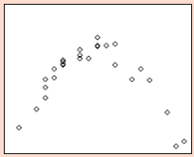
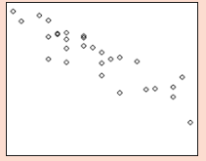
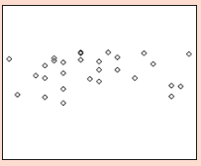
Exercise
Describe each of the graphs below by their corresponding form: linear, curved, or random
The first graph is curved as the points tend toward an upside down U-shape.
The second graph is linear as the points tend toward a straight line.
The last graph shows no clear pattern and could be described as random

Slide 14
Interpreting Scatterplots - Direction
Relationships between two factors is:
"Positively Associated" when as one factor increases in value the other factor also tends to increase in value
"Negatively Associated" when as one factor increases in value the other factor tends to decrease in value

Slide 15
Interpreting Scatterplots - Direction

Slide 16
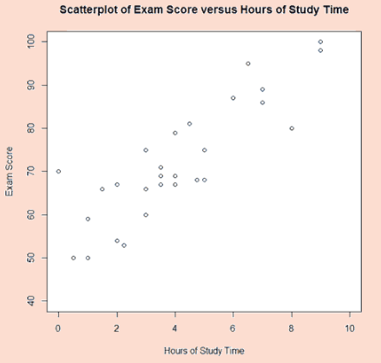
Exercise
Looking at the scatterplot showing the association of Final Exam score with Hours of Study Time, how would you describe the association between these factors?
Positively Associated

Slide 17
Interpreting Scatterplots – Strength of the Relationship
The strength of the association between the factors describes how closely the points appear to follow a clear form or pattern
Scatterplots A and B show the age in months vs length in centimeters of baby koala bear at two different zoos (A and B, respectively).
The association between age in months and length in centimeters is more strongly associated when looking at the data from Zoo B than the data from Zoo A.

Slide 18
Correlation

Slide 19
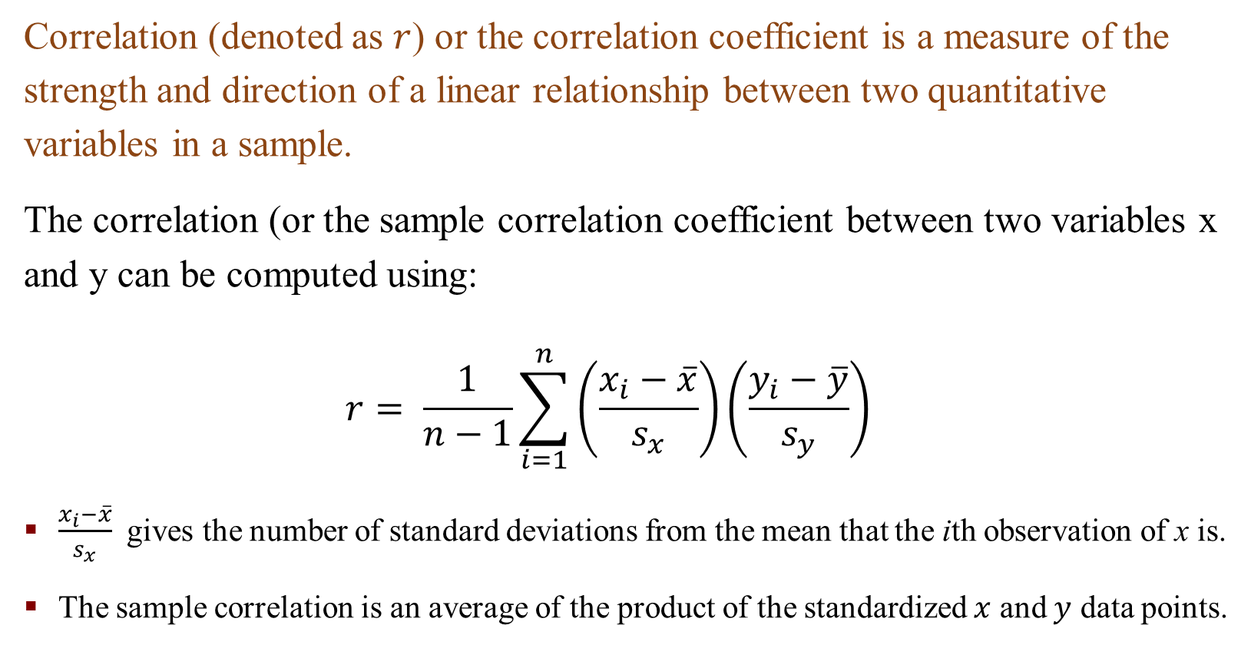
Correlation
Correlation (denoted as $r$) or the correlation coefficient is a measure of the strength and direction of a linear relationship between two quantitative variables in a sample.
The correlation (or the sample correlation coefficient between two variables x and y can be computed using:
$$r= \frac{1}{n−1}\sum_{i=1}^{n}{\left(\frac{x_{i}−\overline{x}}{s_{x}}\right)\left(\frac{y_{i}−\overline{y}}{s_{y}}\right)}$$
$\frac{x_{i}−\overline{x}}{s_{x}}$ gives the number of standard deviations from the mean that the ith observation of x is.
The sample correlation is an average of the product of the standardized $x$ and $y$ data points.
Notes:
How many sds the ith element is away from mean

Slide 20
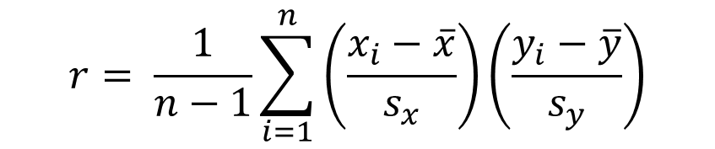
Properties of Correlation
1. The correlation takes on values between -1 and +1
2. The correlation between variables x and y is the same as the correlation between variables y and x
3. Correlations can be computed between paired values of two quantitative variables
4. The correlation coefficient does not have units. It is independent of the unit of measure of variables x and y
5. Correlation measures the strength of a linear relationship only. Correlation should not be used to describe a curved relationship - even if the association is strong
6. Outliers affect correlation. Correlation in the presence of outliers should be interpreted with caution
$$r= \frac{1}{n−1}\sum_{i=1}^{n}{\left(\frac{x_{i}−\overline{x}}{s_{x}}\right)\left(\frac{y_{i}−\overline{y}}{s_{y}}\right)}$$

Slide 21
An Example - Correlation
We have data about age of 5 couples.
Calculate the sample correlation between the ages of husbands and wives

Slide 22
An Example - Correlation

Slide 23
Correlation Coefficients

Slide 24
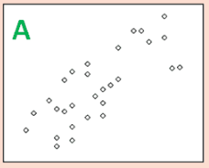
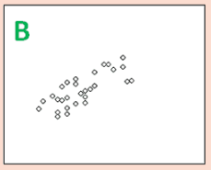
Exercise
Which set of variables has the stronger association?
Though it may initially appear as though the strength of the linear relationship in scatterplot B is stronger than the linear association between variables in scatterplot A, the data in each plot is the same. The difference is the scale of the axes. Scatterplot A is “zoomed in”, while scatterplot B is “zoomed out.” This is apparent on closer inspection once we add in the axes. As such, the amount of white space on a page impacts how we judge the strength of the association

Slide 25
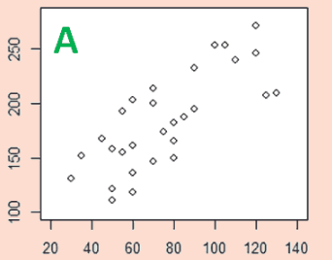
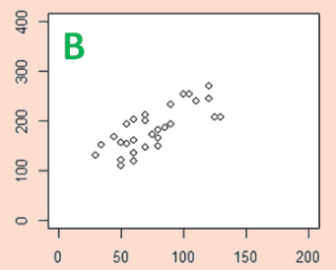
Exercise
The data for each of the scatterplots below is the same. If the correlation in scatterplot A is 0.77, then what is the correlation between the variables in scatterplot B?
The correlation between variables in B is the same as the correlation between variables in scatterplot A (since the data is the same). The correlation, then, is 0.77

Slide 26
R Function cor()
Use cor() to calculate the sample correlation coefficient

Slide 27
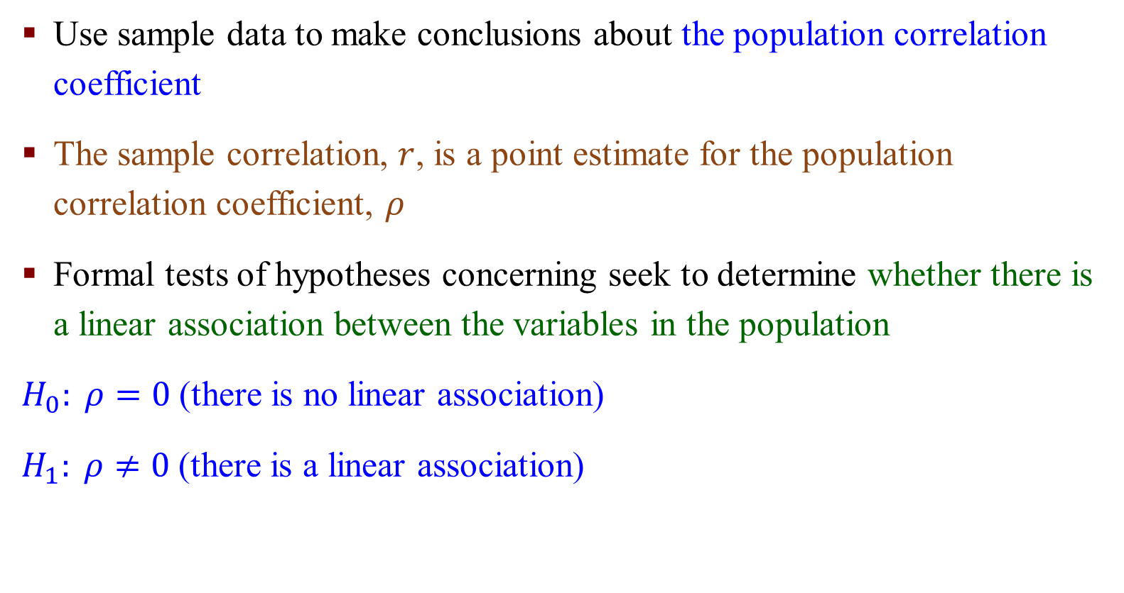
Inference about Population Correlation Coefficient
Use sample data to make conclusions about the population correlation coefficient
The sample correlation, $r$, is a point estimate for the population correlation coefficient, $ρ$
Formal tests of hypotheses concerning seek to determine whether there is a linear association between the variables in the population
$H_{0}: ρ=0$(there is no linear association)
$H_{1}: ρ≠0$ (there is a linear association)
Notes:
$ρ$ pho, rou

Slide 28
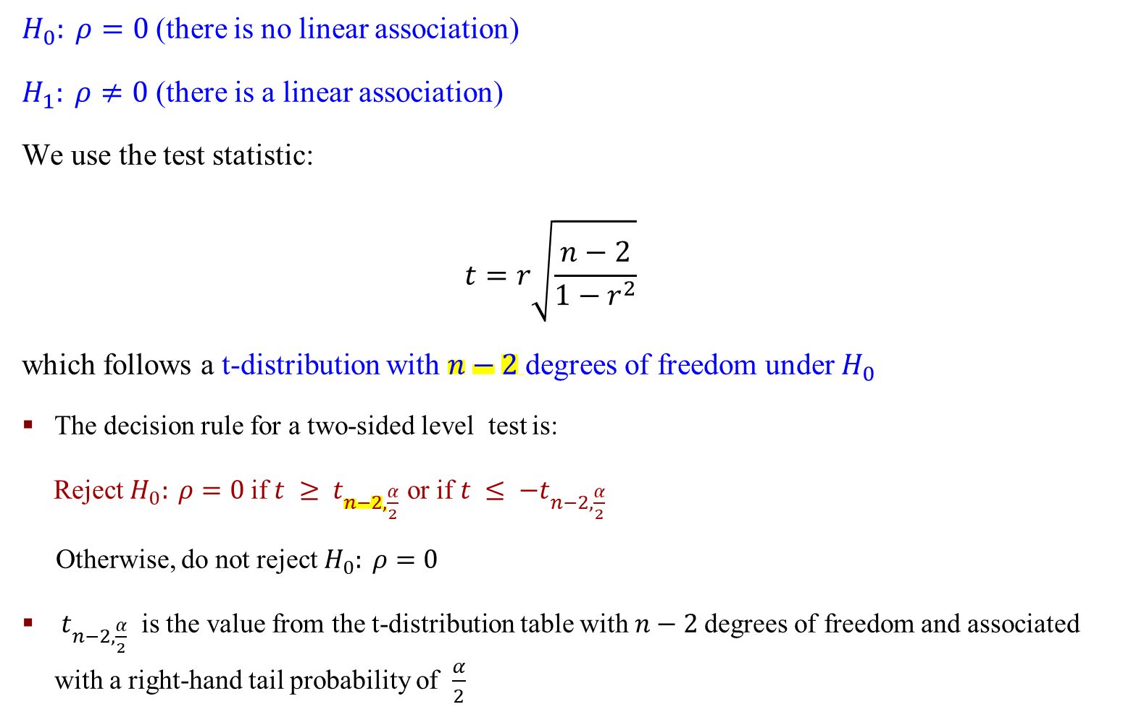
Inference about Population Correlation Coefficient
$H_{0}: ρ=0$(there is no linear association)
$H_{1}: ρ≠0$ (there is a linear association)
We use the test statistic:
$$t=r\sqrt{\frac{n−2}{1−r^{2}}}$$
which follows a t-distribution with $n−2$degrees of freedom under $H_{0}$
The decision rule for a two-sided level test is:
Reject $H_{0}: ρ=0$if $t ≥ t_{n−2,\frac{α}{2}}$ or if $t ≤ {−t}_{n−2,\frac{α}{2}}$
Otherwise, do not reject $H_{0}: ρ=0$
$t_{n−2,\frac{α}{2}}$ is the value from the t-distribution table with $n−2$degrees of freedom and associated with a right-hand tail probability of $\frac{α}{2}$
Notes:
$ρ$ pho

Slide 29
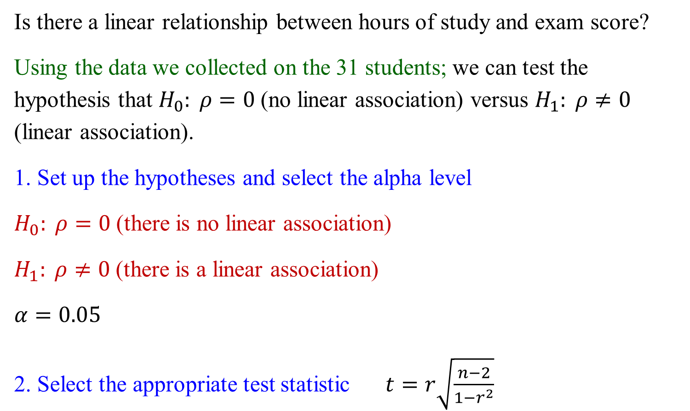
An Example - Inference
Is there a linear relationship between hours of study and exam score?
Using the data we collected on the 31 students; we can test the hypothesis that $H_{0}: ρ=0$(no linear association) versus $H_{1}: ρ≠0$ (linear association).
1. Set up the hypotheses and select the alpha level
$H_{0}: ρ=0$(there is no linear association)
$H_{1}: ρ≠0$ (there is a linear association)
$$α=0.05$$
2. Select the appropriate test statistic $t=r\sqrt{\frac{n−2}{1−r^{2}}}$

Slide 30
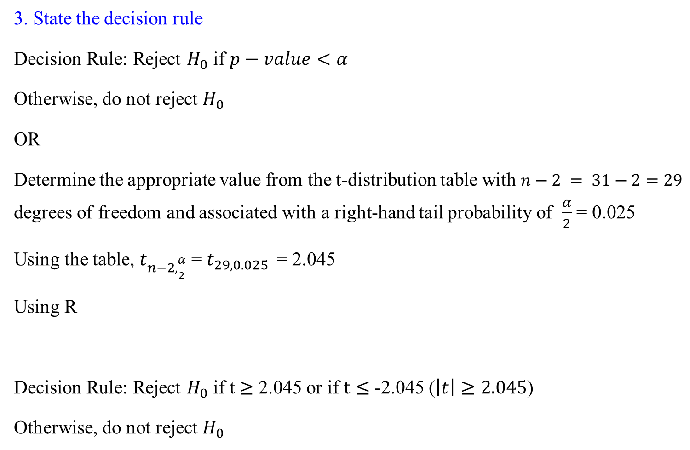
An Example - Inference
3. State the decision rule
Decision Rule: Reject $H_{0}$ if $p−value<α$
Otherwise, do not reject $H_{0}$
OR
Determine the appropriate value from the t-distribution table with $n−2 = 31−2=29$ degrees of freedom and associated with a right-hand tail probability of $\frac{α}{2}$ = 0.025
Using the table, $t_{n−2,\frac{α}{2}}$ = $t_{29,0.025 }$ = 2.045
Using R
Decision Rule: Reject $H_{0}$ if t $≥$ 2.045 or if $t≤$ -2.045 ($\left|t\right|≥2.045$)
Otherwise, do not reject $H_{0}$

Slide 31
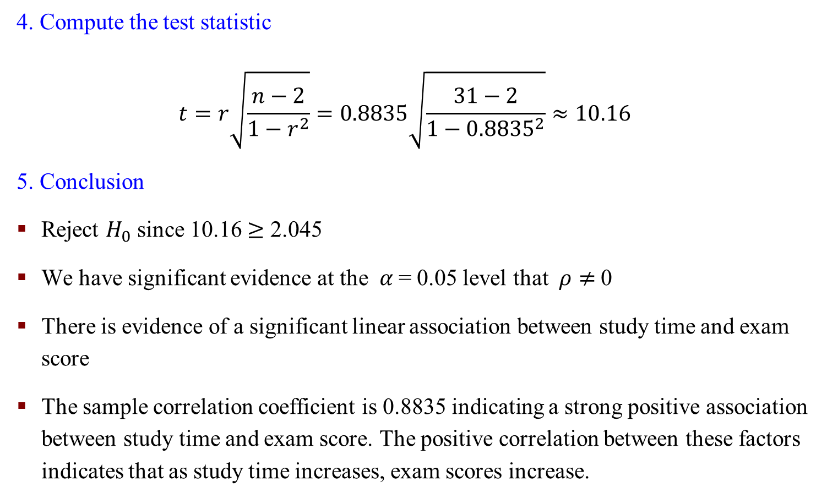
An Example - Inference
4. Compute the test statistic
$$t=r\sqrt{\frac{n−2}{1−r^{2}}}=0.8835\sqrt{\frac{31−2}{1−{0.8835}^{2}}}≈10.16$$
5. Conclusion
Reject $H_{0}$ since 10.16 $≥$ 2.045
We have significant evidence at the $α$= 0.05 level that $ρ≠$0
There is evidence of a significant linear association between study time and exam score
The sample correlation coefficient is 0.8835 indicating a strong positive association between study time and exam score. The positive correlation between these factors indicates that as study time increases, exam scores increase.

Slide 32
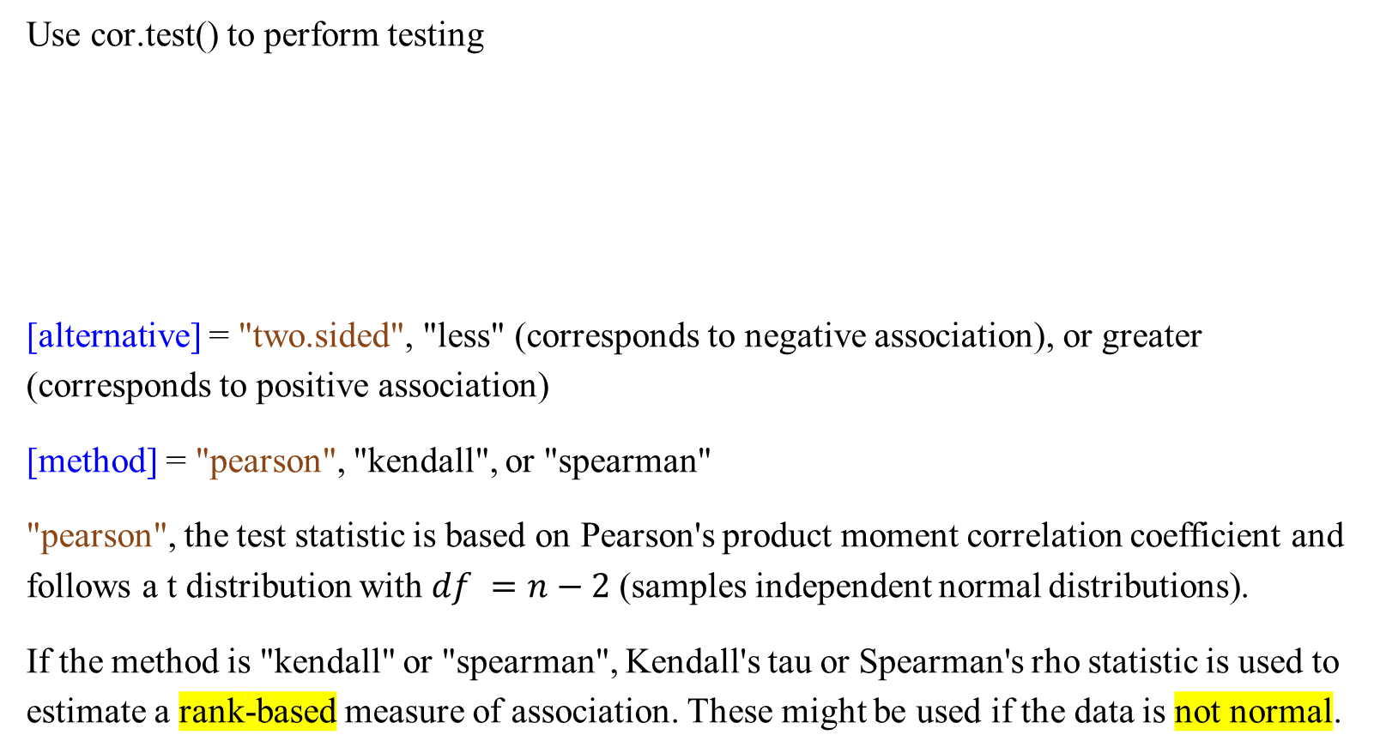
R Function cor.test()
Use cor.test() to perform testing
[alternative] = "two.sided", "less" (corresponds to negative association), or greater (corresponds to positive association)
[method] = "pearson", "kendall", or "spearman"
"pearson", the test statistic is based on Pearson's product moment correlation coefficient and follows a t distribution with $df =n−2$(samples independent normal distributions).
If the method is "kendall" or "spearman", Kendall's tau or Spearman's rho statistic is used to estimate a rank-based measure of association. These might be used if the data is not normal.

Slide 33
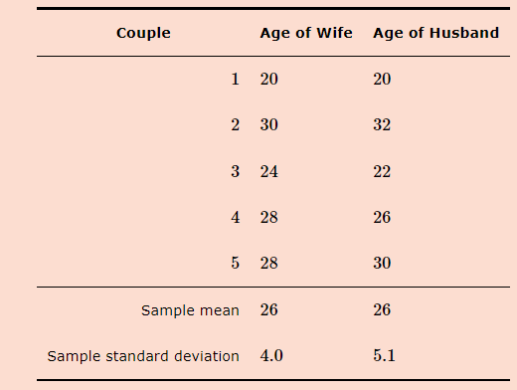
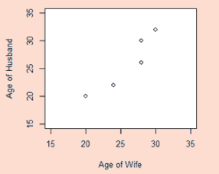

Exercise
Is there a linear association between the ages of husbands and wives among all couples? Use the previously calculated value of r = .93 to help with your assessment $t=r\sqrt{\frac{n−2}{1−r^{2}}}$
Using the data we collected from the 5 couples, we can test the hypothesis that H₀: ρ=0 (no linear association) versus H₁: ρ≠0 (linear association),$α=0.05$

Slide 34
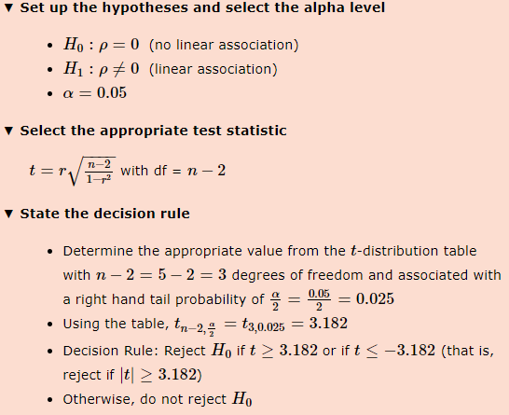
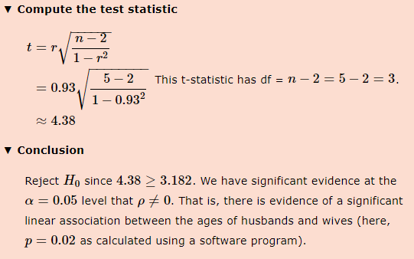
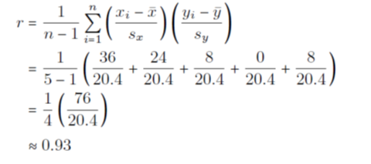

Slide 35
Simple Linear Regression

Slide 36
Simple Linear Regression (SLR)
If a linear relationship exists, we can model the nature of the relationship between the variables using simple linear regression (SLR).
Using SLR, we assert a straight line on the scatterplot that represents the best-fitting line to the data that captures the pattern of the relationship.
An explanatory variable.
A response variable
We build a data model that allows us to:
Quantify the relationship between the response variable and the explanatory variable
Predict the response of a new observation with a given value for x or what the average response is for observations with a specific value for the explanatory variable

Slide 37
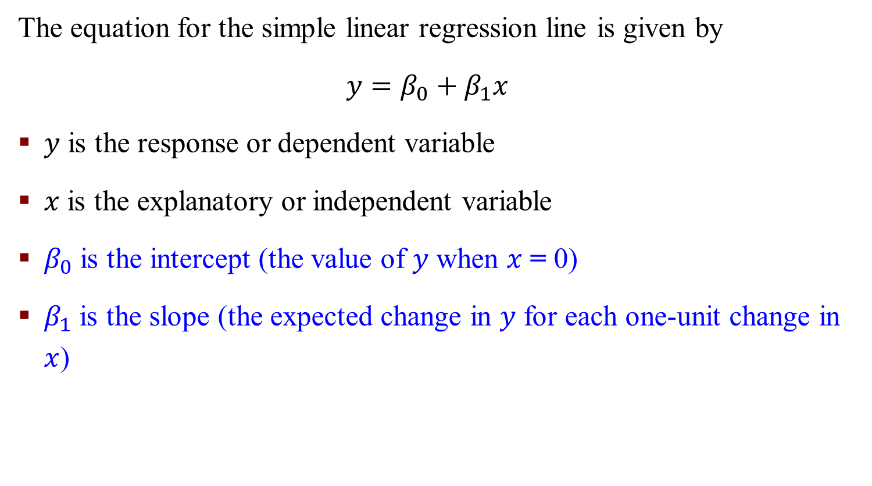
Simple Linear Regression (SLR)
The equation for the simple linear regression line is given by
$$y=β_{0}+β_{1}x$$
$y$ is the response or dependent variable
$x$ is the explanatory or independent variable
$β_{0}$ is the intercept (the value of $y$ when $x$ = 0)
$β_{1}$ is the slope (the expected change in $y$ for each one-unit change in $x$)

Slide 38
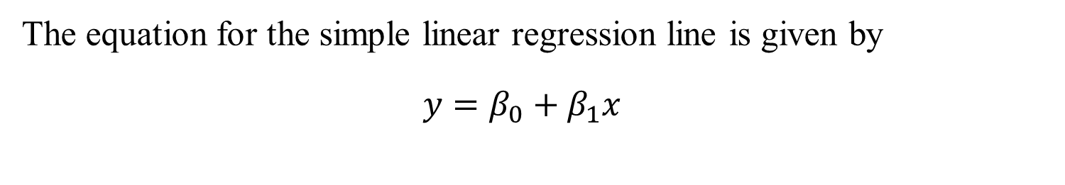
Simple Linear Regression (SLR)
The equation for the simple linear regression line is given by
$$y=β_{0}+β_{1}x$$

Slide 39
How to find the regression line that best fits the data
There are several ways to find the parameters of the line. The most common way is to minimize the sum of the squares of the distances between the points and the regression line.
This approach is called the least-squares method. We want to minimize the vertical distance between each of the points and the regression line.

Slide 40

How to find the regression line that best fits the data
$$y_{i}=β_{0}+β_{1}x_{i}+ε_{i}$$
$$ε_{i}=y_{i}−{(β}_{0}+β_{1}x_{i})$$
$$ε\left(β_{0},β_{1}\right)=\sum_{i=1}^{n}{(y_{i}−{(β}_{0}+β_{1}x_{i}) )2}$$
Loss function, L2-norm
Notes:
$ε$ epsilon
L1 abs value
L2 square value

Slide 41
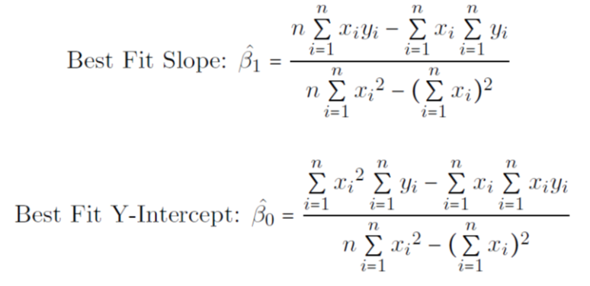

How to find the regression line that best fits the data
$$y_{i}=β_{0}+β_{1}x_{i}+ε_{i}$$

Slide 42
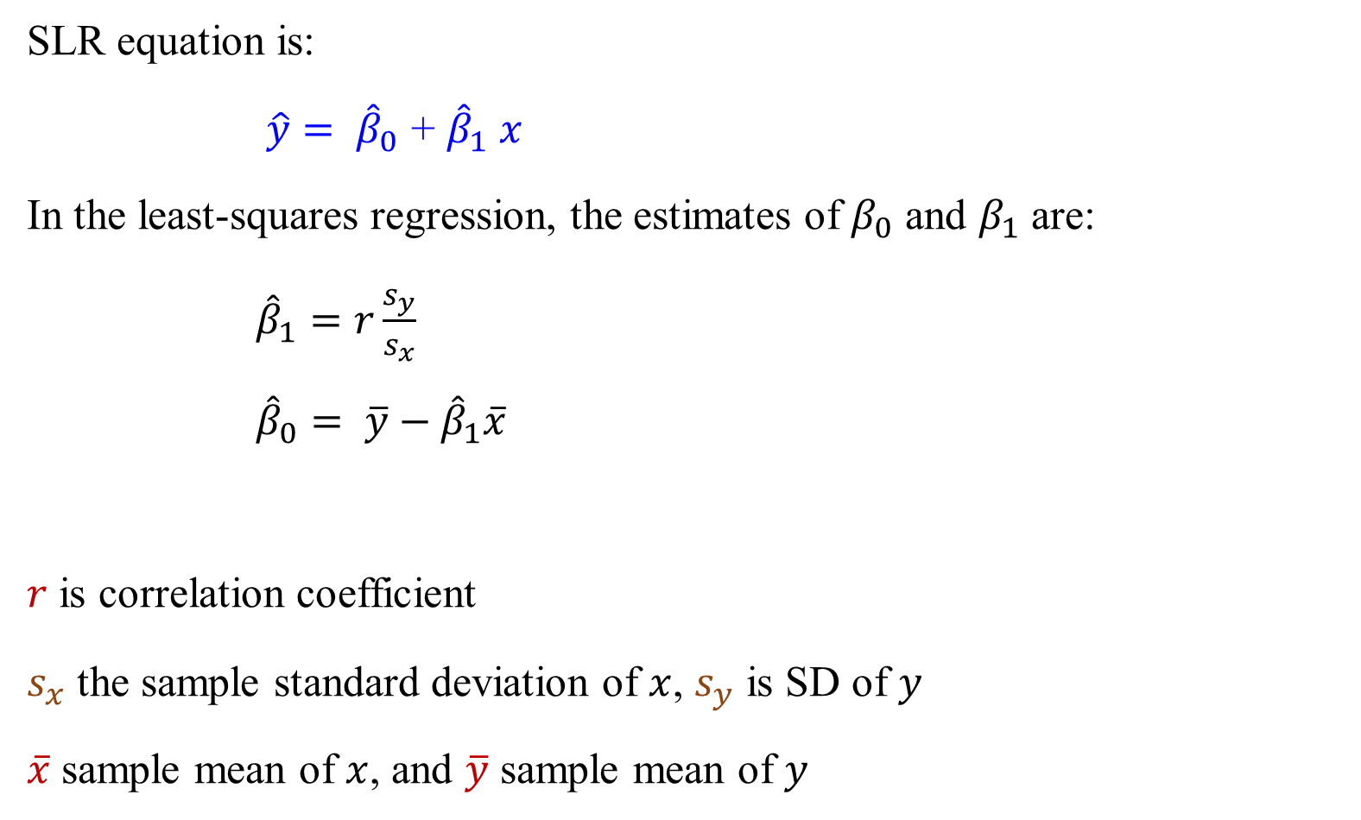
Equation for the least-squares regression line
SLR equation is:
$\hat{y}= {\hat{β}}_{0}$ + ${\hat{β}}_{1} x$
In the least-squares regression, the estimates of $β_{0}$ and $β_{1}$ are:
${\hat{β}}_{1}=r\frac{s_{y}}{s_{x}}$
${\hat{β}}_{0}= \overline{y}−{\hat{β}}_{1}\overline{x}$
$r$ is correlation coefficient
$s_{x}$ the sample standard deviation of $x$, $s_{y}$ is SD of $y$
$\overline{x}$ sample mean of $x$, and $\overline{y}$ sample mean of $y$

Slide 43

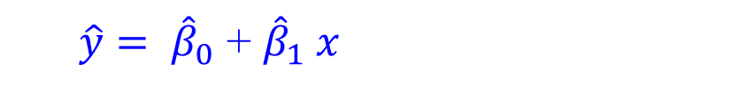
Exercise
We calculated the correlation (r ≈ 0.93) between the ages of husbands and wives from a small sample. Now, find the least-squares regression equation predicting husband’s age from the age of the wife
$\hat{y}= {\hat{β}}_{0}$ + ${\hat{β}}_{1} x$
$${\hat{β}}_{1}=r\frac{s_{y}}{s_{x}}$$
$${ \hat{β}}_{0}= \overline{y}−{\hat{β}}_{1}\overline{x}$$

Slide 44
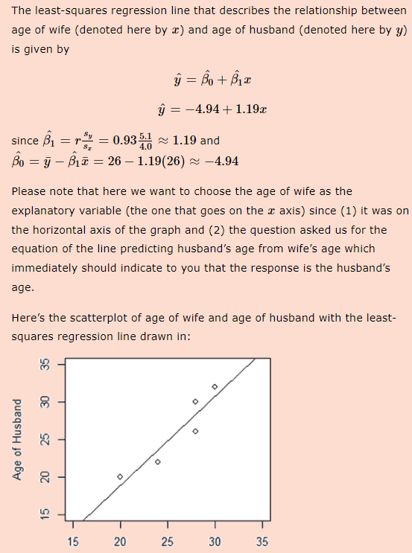
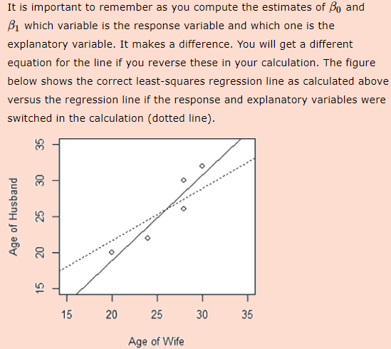

Slide 45
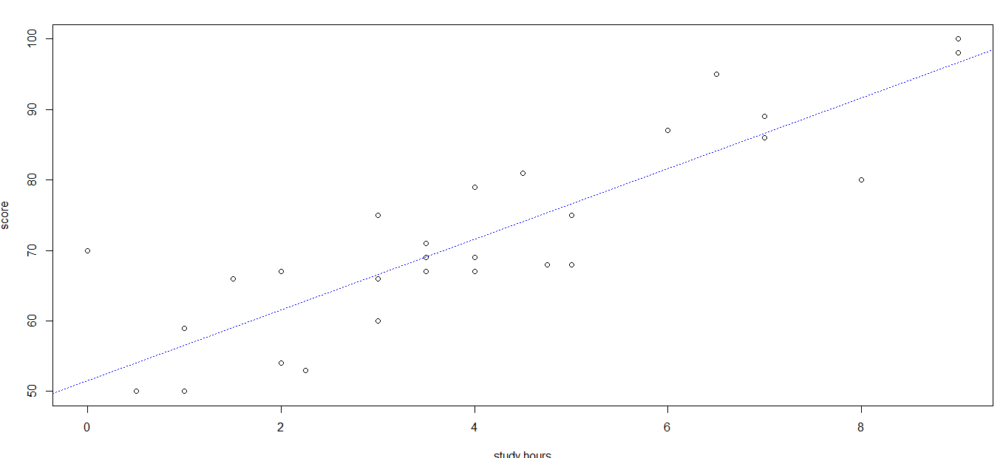
R Function – Simple Linear Regression
> plot(study.hours, score)
http://www.cookbook-r.com/Graphs/Shapes_and_line_types
Notes:
lm: fitting linear model

Slide 46
An Example – Least-squares Regression Line
National Unemployment Male Vs. Female Reference: Statistical Abstract of the United States

